Slide 1

LET THE GAMES BEGIN: An Evaluation of Gamification for Health Informatics Students
ENG 512 Fall 2018 Theory and Research in Professional Writing Huiling Ding, PhD
Kelia S. Ray
19 November 2018

Slide 2
LET THE GAMES BEGIN: An Evaluation of Gamification for Health Informatics Students
ENG 512 Fall 2018 Theory and Research in Professional Writing Huiling Ding, PhD
Kelia S. Ray
ksray2@ncsu.edu
19 November 2018

Slide 3

Annotated Bibliography
Kelia S. Ray
MSTC Technical Communication 2020
BS HIM Health Information Mgr 2018
TC-S Surgical Technology 2009

Slide 4


Gamifying Education
This 21st century trend plays a significant role in transforming online educational programs
4

Slide 5

FRAMEWORK: Learning Theory & Games Theory

Slide 6



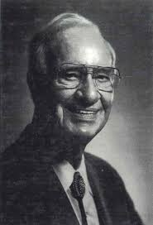



Knowles’ Andragogy
Ready to Learn
Problem- Centeredness
Need to Know
Theory of the Adult Learner.
Adult Learning Experience
Self-Learning
Motivation

Slide 7
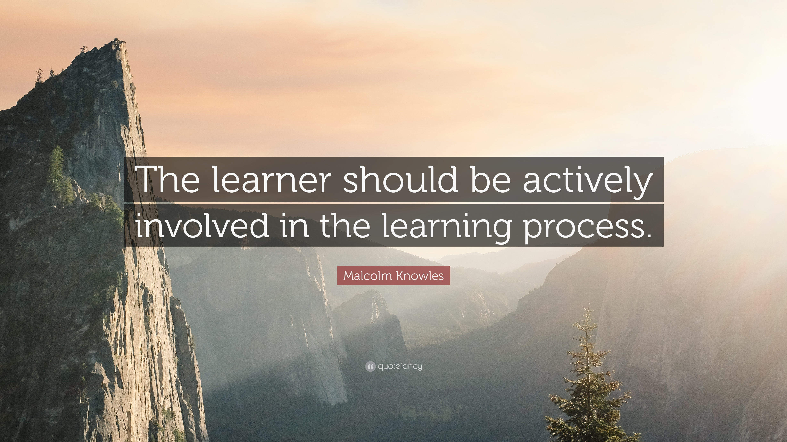

Slide 8

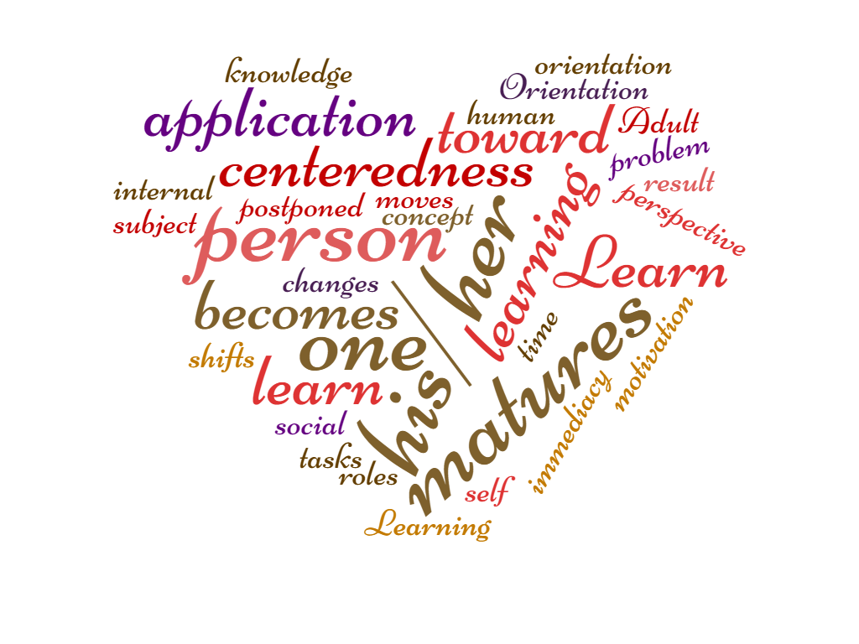

Slide 9

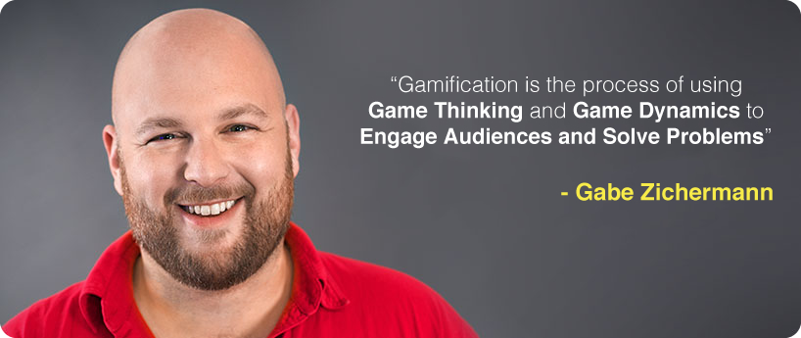
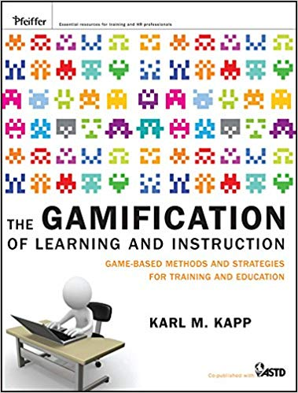
Game Theory
This Photo by Unknown Author is licensed under CC BY-NC-ND
“Games engage players to overcome self-imposed challenges by means of intrinsic motivations.”

Slide 10

Motivation: “A key concept of game play is motivation” (Kapp, 2012).
Anticipated reward: Employment
Intrinsic: Self fulfillment
Increased Engagement: Fun
10

Slide 11

Welcome to Health Informatics 101
CLASS Procedures
World’s Best Teacher

Slide 12
According to the U.S. Bureau of Labor Statistics (2010) 10 of the top 20 occupations with the fastest growth are in healthcare.

Slide 13
Health Informatics Consultant. Health Informatics Director. Nursing Informatics Specialist. Chief Medical Information Officer. Electronic Medical Record Keeper.
CLASS Procedures
World’s Best Teacher

Slide 14





Results
Online Adult Education
Health Informatics Education
Novel Curriculum
Technical Communication
14

Slide 15

Online Adult Education
This requires a fundamental change for educators, from didactic teacher to learning facilitator.

Slide 16



Healthcare education needs to move toward an emphasis of “competent performance through active learning” (IOM, 2010).
16
This Photo by Unknown Author is licensed under CC BY-SA

Slide 17


Novel Curriculum
Blended Learning combines face-to-face instruction with gamification
17

Slide 18


Technical Communication
Translators of game development communication to the world
18

Slide 19
Discussion
Global healthcare gamification reaches $4.2 billion by 2022
Estimated global healthcare gamification could reach $13.5 billion by 2025.
Notes:
You can use this slide as your opening or closing slide. Should you choose to use it as a closing, make sure you review the main points of your presentation. One creative way to do that is by adding animations to the various graphics on a slide. This slide has 4 different graphics, and, when you view the slideshow, you will see that you can click to reveal the next graphic. Similarly, as you review the main topics in your presentation, you may want each point to show up when you are addressing that topic.
Add animation to images and graphics:
Select your image or graphic.
Click on the Animations tab.
Choose from the options. The animation for this slide is “Split”. The drop-down menu in the Animation section gives even more animations you can use.
If you have multiple graphics or images, you will see a number appear next to it that notes the order of the animations.
Note: You will want to choose the animations carefully. You do not want to make your audience dizzy from your presentation.

Slide 20




Implications
20
Thi Photo by Unknown Author is licensed under CC BY-SA-NC

Slide 21
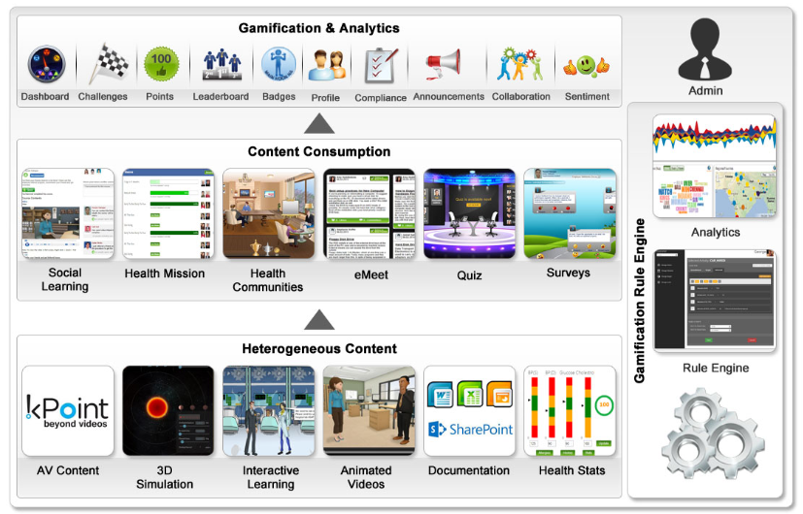
Limitations
21
Thi Photo by Unknown Author is licensed under CC BY-SA-NC

Slide 22
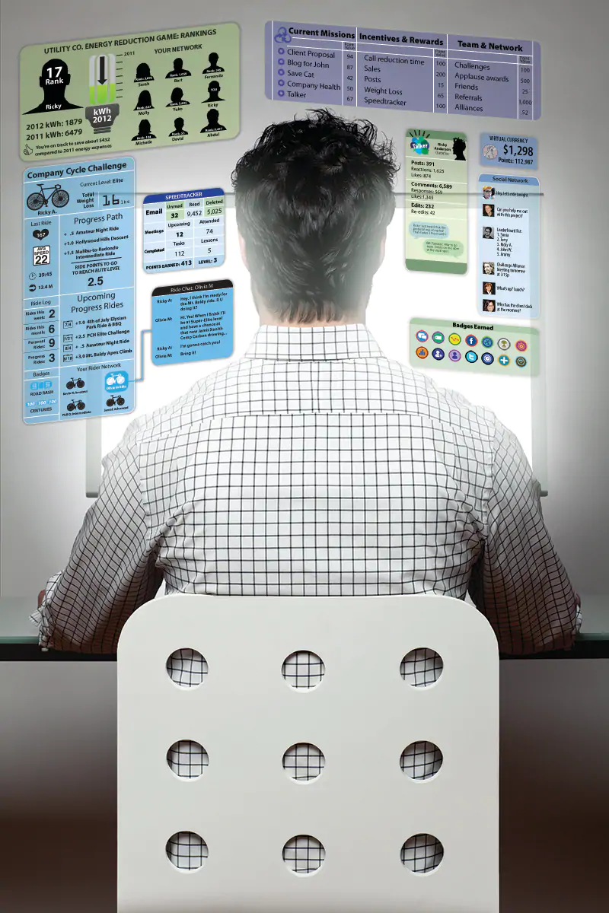

Slide 23
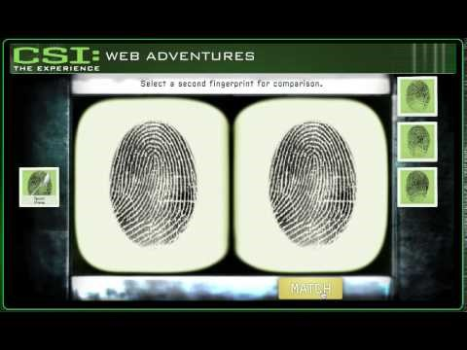


Slide 24

Conclusion
Gamification uses game-based mechanics, and game thinking to engage people, motivate action, promote learning, and solve problems.
Gamification can be applied to industries such as retail to computer services to education (Zichermann, 2018).
Educators, are responsible to take a leadership position in the gamification of learning and instruction (Kapp, 2012).
Technical communicators are needed to add a layer of mediation to prevent ineffective written communication(Selwyn, 2005).

Slide 25

THANK YOU
Email ksray2@ncsu.edu

Slide 26
THANK YOU
Email ksray2@ncsu.edu

